Slide 1
Clustering
Clustering of data is a method by which large sets of data is grouped into clusters of smaller sets of similar data.
Objects in one cluster have high similarity to each other and are dissimilar to objects in other clusters.
It is an example of unsupervised learning.

Slide 2
General Applications of Clustering
Pattern Recognition
Spatial Data Analysis
  detect spatial clusters and explain them in spatial data mining
Image Processing
Economic Science (especially market research)
WWW
  Document classification
  Cluster Web log data to discover groups of similar access patterns

Slide 3
Examples of Clustering Applications
Marketing: Help marketers discover distinct groups in their customer bases, and then use this knowledge to develop targeted marketing programs
Land use: Identification of areas of similar land use in an earth observation database
Insurance: Identifying groups of motor insurance policy holders with a high average claim cost
City-planning: Identifying groups of houses according to their house type, value, and geographical location
Earth-quake studies: Observed earth quake epicenters should be clustered along continent faults

Slide 4
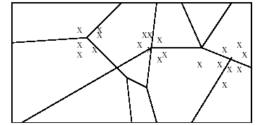
Clustering Applications
Many years ago, during a cholera outbreak in London, a physician plotted the location of cases on a map, getting a plot that looked like Fig. Properly visualized, the data indicated that cases clustered around certain intersections, where there were polluted wells, not only exposing the cause of cholera, but indicating what to do about the problem. Alas, not all data mining is this easy, often because the clusters are in so many dimensions that visualization is very hard.

Slide 5
Clustering Applications
Documents may be thought of as points in a high-dimensional space, where each dimension corresponds to one possible word. The position of a document in a dimension is the number of times the word occurs in the document (or just 1 if it occurs, 0 if not). Clusters of documents in this space often correspond to groups of documents on the same
Skycat clustered 2x109 sky objects into stars, galaxies, quasars, etc. Each object was a point in a space of 7 dimensions, with each dimension representing radiation in one band of the spectrum. The Sloan Sky Survey is a more ambitious attempt to catalog and cluster the entire visible universe.

Slide 6
Clustering Houses
Geographic Distance Based
Groups of homes
Size Based

Slide 7
Clustering Problem
Given a database D={t₁,t₂,…,t_{n}} of tuples and an integer value k, the Clustering Problem is to define a mapping f:D→g{1,..,k} where each t_{i} is assigned to one cluster K_{j}, 1<=j<=k.
A Cluster, K_{j}, contains precisely those tuples mapped to it.
Unlike classification problem, clusters are not known a priori.

Slide 8
Clustering Vs. Classification
No prior knowledge
  Number of clusters
  Meaning of clusters
Unsupervised learning

Slide 9
Clustering Issues
Outlier handling
Dynamic data
Interpreting results
Evaluating results
Number of clusters
Data to be used
Scalability

Slide 10

Types of Data in Cluster Analysis
Data matrix
also called Object by variable structure
represents n objects with p variables (attributes or measures
a relational table or n by p matrix

Slide 11

Types of Data in Cluster Analysis
Dissimilarity matrix
also called Object by object structure
represents proximities of pairs of objects
d(i,j) : is the measured difference or dissimilarity between objects i and j.
: Nonnegative
: near 0 when objects are highly similar

Slide 12
Dissimilarity Matrix
Many clustering algorithms operate on dissimilarity matrix
If data matrix is given, it needs to be transformed into a dissimilarity matrix first
How can we assess dissimilarity d(i,j)?

Slide 13
Types of Data
Interval-scaled variables
Binary variables
Nominal, ordinal, and ratio variables
Variables of mixed types

Slide 14
Interval-scales Variables
Continuous measurements of a roughly linear scale
Weight, height, latitude and longitude coordinates, temperature, etc.
Effect of measurement units in attributes
    Smaller unit Larger variable range
    Larger effect to the clustering structure
Standardization + background knowledge
Clustering Basket ball player may require giving more weightage to height

Slide 15


Standardizing Variables
Standardize data for a variable f
  Calculate the mean absolute deviation:
  where x_{1f},..x_{nf} are n measurements of f &
  Calculate the standardized measurement (z-score)
Using mean absolute deviation is more robust than using standard deviation as z-scores of outliers do not become too small and so they remain detectable

Slide 16

Similarity & dissimilarity between Objects
Distances are normally used to measure the similarity or dissimilarity between two data objects
Minkowski distance:
  where i = (xi1, xi2, …, xip) and j = (xj1, xj2, …, xjp) are two p-dimensional data objects, and q is a positive integer
If q = 1, d is Manhattan/city block distance
If q = 2, d is Euclidean distance
Weighted distance

Slide 17
Properties of Minkowski Distance
    d(i,j) ≥ 0 Nonnegativity
    d(i,i) = 0 Distance from an object to itself is 0
    d(i,j) = d(j,i) Symmetric
    d(i,j) ≤ d(i,k) + d(k,j) Triangular inequality
k
i
j

Slide 18


Binary Variables
A contingency table for binary data
0-varaible absent
1-variable present
Simple matching coefficient (invariant, if the binary variable is symmetric):
Jaccard coefficient (noninvariant if the binary variable is asymmetric):
Object j
1
0
sum
1
a
b
a
+
b
Object i
0
c
d
c
+
d
sum
a
+
c
b
+
d
p

Slide 19


Dissimilarity between Binary Variables
Example
  gender is a symmetric attribute
  the remaining attributes are asymmetric binary
  let the values Y and P be set to 1, and the value N be set to 0

Slide 20

Nominal Variables
A generalization of the binary variable in that it can take more than 2 states, e.g., red, yellow, blue, green
Method 1: Simple matching
  m: # of matches, p: total # of variables
Method 2: use a large number of binary variables
  creating a new binary variable for each of the M nominal states

Slide 21


Ordinal Variables
An ordinal variable can be discrete or continuous
order is important, e.g., rank
Can be treated like interval-scaled
  replacing x_{if} by their rank
  map the range of each variable onto [0, 1] by replacing i-th object in the f-th variable by
  compute the dissimilarity using methods for interval-scaled variables

Slide 22
Ratio-Scaled Variables
Ratio-scaled variable: a positive measurement on a nonlinear scale, approximately at exponential scale, such as Ae^{Bt} or Ae^{-Bt}
Methods:
  treat them like interval-scaled variables — not a good choice! (why?)
  apply logarithmic transformation
y_{if} = log(x_{if})
  treat them as continuous ordinal data treat their rank as interval-scaled.

Slide 23


Variables of Mixed Types
A database may contain all the six types of variables
  symmetric binary, asymmetric binary, nominal, ordinal, interval and ratio.
One may use a weighted formula to combine their effects.
Where δ_{ij}=0 if x_{if} or x_{jf} is missing or x_{if}=x_{jf}=0 and f is an asymmetric binary
d_{ij} is computed as
  f is binary or nominal:
    d_{ij} = 0 if x_{if} = x_{jf} , or d_{ij}^{(f)} = 1 o.w.
  f is interval-based: use the normalized distance
  f is ordinal or ratio-scaled
    compute ranks r_{if} and
    and treat z_{if} as interval-scaled

Slide 24
Distance Between Clusters
If | p – p’ | is distance between two points or two objects, m_{i} is mean of cluster C_{i} and n_{i} is number of objects in C_{i}, then
Minimum distance:
d_{min}(C_{i}, C_{j}) = min_{p∈Ci , p’∈Cj} | p – p’ |
Maximum distance:
d_{max}(C_{i}, C_{j}) = max_{p∈Ci , p’∈Cj} | p – p’ |
Mean distance:
d_{mean}(C_{i}, C_{j}) = | m_{i} – m_{j} |
Average distance:
  d_{avg}(C_{i}, C_{j}) = 1/(n_{i}n_{j}) ∑_{p∈Ci} ∑_{p’∈Cj} | p – p’ |

Slide 25
Similarity Measures
If i = (x_{i1}, x_{i2}, …, x_{ip},) and j = (x_{j1}, x_{j2}, …, x_{jp}) are two p-dimensional data objects, then
Euclidean distance
d
(
i
,
j
)
=
x
−
x
2
+
x
−
x
2
+
...
+
x
−
x
2
i
1
j
1
i
2
j
2
ip
jp
Manhattan distance
d
(
i
,
j
)
=
x
−
x
+
x
−
x
+
...
+
x
−
x
i
1
j
1
i
2
j
2
ip
jp
Minkowski distance
(
)
q
q
q
1
/
q
d
(
i
,
j
)
=
x
−
x
+
x
−
x
+
...
+
x
−
x
i
1
j
1
i
2
j
2
ip
jp

Slide 26
What Is Good Clustering?
A good clustering method will produce high quality clusters with
  high intra-class similarity
  low inter-class similarity
The quality of a clustering result depends on both the similarity measure used by the method and its implementation.
The quality of a clustering method is also measured by its ability to discover some or all of the hidden patterns.

Slide 27
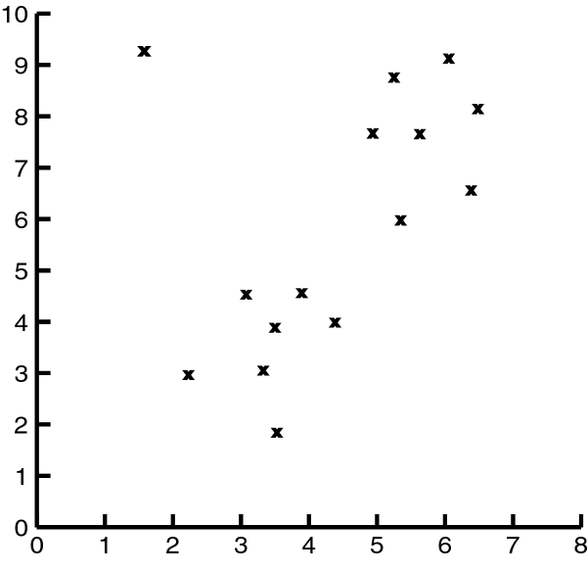
Impact of Outliers on Clustering

Slide 28
Problems with Outliers
Many clustering algorithms take as input the number of clusters
Some clustering algorithms find and eliminate outliers
Statistical techniques to detect outliers
Discordancy Test
Not very realistic for real life data

Slide 29
Clustering Approaches
Clustering
Hierarchical
Partitional
Density-based
Grid-based

Slide 30
Partitioning Algorithms: Basic Concept
Partitioning method: Construct a partition of a database D of n objects into a set of k clusters
Given a k, find a partition of k clusters that optimizes the chosen partitioning criterion
  Global optimal: exhaustively enumerate all partitions
  Heuristic methods: k-means and k-medoids algorithms
  k-means (MacQueen’67): Each cluster is represented by the center of the cluster
  k-medoids or PAM (Partition around medoids) (Kaufman & Rousseeuw’87): Each cluster is represented by one of the objects in the cluster

Slide 31
K-means
Works when we know k, the number of clusters we want to find
Idea:
  Randomly pick k points as the “centroids” of the k clusters
  Loop:
    For each point, put the point in the cluster to whose centroid it is closest
    Recompute the cluster centroids
    Repeat loop (until there is no change in clusters between two consecutive iterations.)
Iterative improvement of the objective function:
Sum of the squared distance from each point to the centroid of its cluster

Slide 32
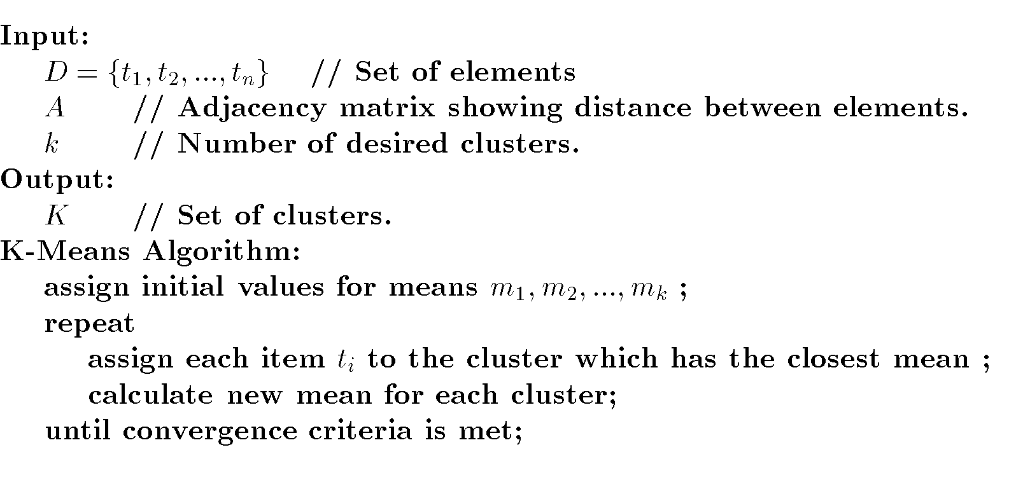
K-Means Algorithm

Slide 33
K-means Example
For simplicity, 1-dimension objects and k=2.
  Numerical difference is used as the distance
Objects: 1, 2, 5, 6,7
K-means:
  Randomly select 5 and 6 as centroids;
  => Two clusters {1,2,5} and {6,7}; meanC1=8/3, meanC2=6.5
  => {1,2}, {5,6,7}; meanC1=1.5, meanC2=6
  => no change.
  Aggregate dissimilarity
    (sum of squares of distance each point of each cluster from its cluster center--(intra-cluster distance)
  = 0.5²+ 0.5²+ 1²+ 0²+1² = 2.5
|1-1.5|²

Slide 34

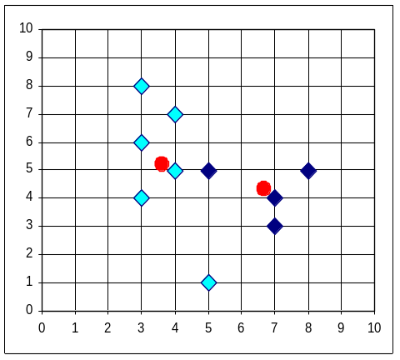


K-Means Example

Slide 35
K-Means Example
Given: {2,4,10,12,3,20,30,11,25}, k=2
Randomly assign means: m₁=3,m₂=4
K₁={2,3}, K₂={4,10,12,20,30,11,25}, m₁=2.5,m₂=16
K₁={2,3,4},K₂={10,12,20,30,11,25}, m₁=3,m₂=18
K₁={2,3,4,10},K₂={12,20,30,11,25}, m₁=4.75,m₂=19.6
K₁={2,3,4,10,11,12},K₂={20,30,25}, m₁=7,m₂=25
Stop as the clusters with these means are the same.

Slide 36
Pros & Cons of K-means
Relatively efficient: O(tkn)
n: # objects, k: # clusters, t: # iterations; k, t << n.
Applicable only when mean is defined
What about categorical data?
Need to specify the number of clusters
Unable to handle noisy data and outliers

Slide 37
Problems with K-means
Need to know k in advance
  Could try out several k?
    Unfortunately, cluster tightness increases with increasing K. The best intra-cluster tightness occurs when k=n (every point in its own cluster)
Tends to go to local minima that are sensitive to the starting centroids
  Try out multiple starting points
Disjoint and exhaustive
  Doesn’t have a notion of “outliers”
    Outlier problem can be handled by K-medoid or neighborhood-based algorithms
Assumes clusters are spherical in vector space

Slide 38
Bisecting K-means
Can pick the largest
Cluster or the cluster
With lowest average
similarity
For i=1 to k-1 do{
  Pick a leaf cluster C to split
  For j=1 to ITER do{
    Use K-means to split C into two sub-clusters, C₁ and C₂
    Choose the best of the above splits and make it permanent}
  }
Divisive hierarchical clustering method
uses K-means

Slide 39
Nearest Neighbor
Items are iteratively merged into the existing clusters that are closest.
Incremental
Threshold, t, used to determine if items are added to existing clusters or a new cluster is created.

Slide 40
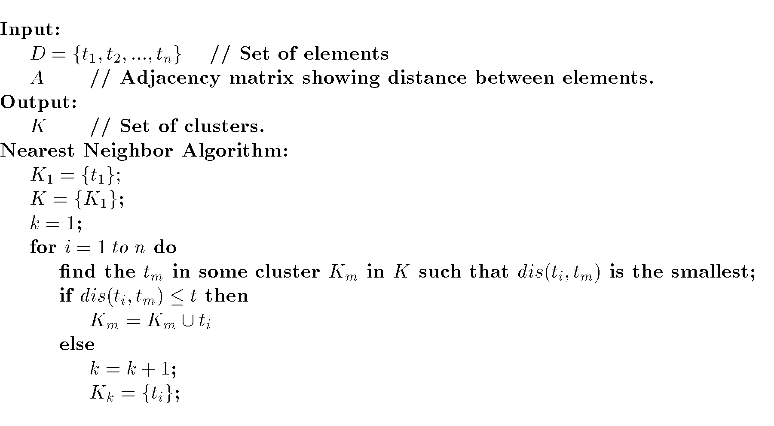
Nearest Neighbor Algorithm

Slide 41
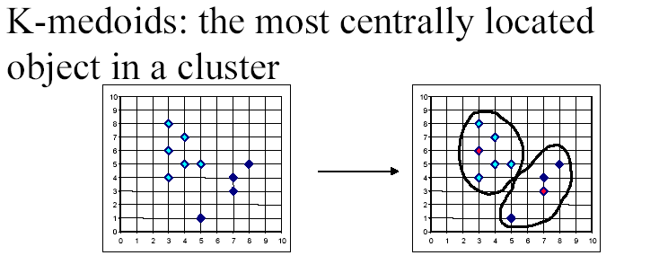
K-medoids

Slide 42
PAM (Partitioning Around Medoids)
K-Medoids
Handles outliers well.
Ordering of input does not impact results.
Does not scale well.
Each cluster represented by one item, called the medoid.
Initial set of k medoids randomly chosen.

Slide 43
PAM: Basic Strategy
First find a representative object (the medoid) for each cluster
Each remaining object is clustered with the medoid to which it is most “similar”
Iteratively replace one of the medoids by a non-medoid as long as the “quality” of the clustering is improved

Slide 44
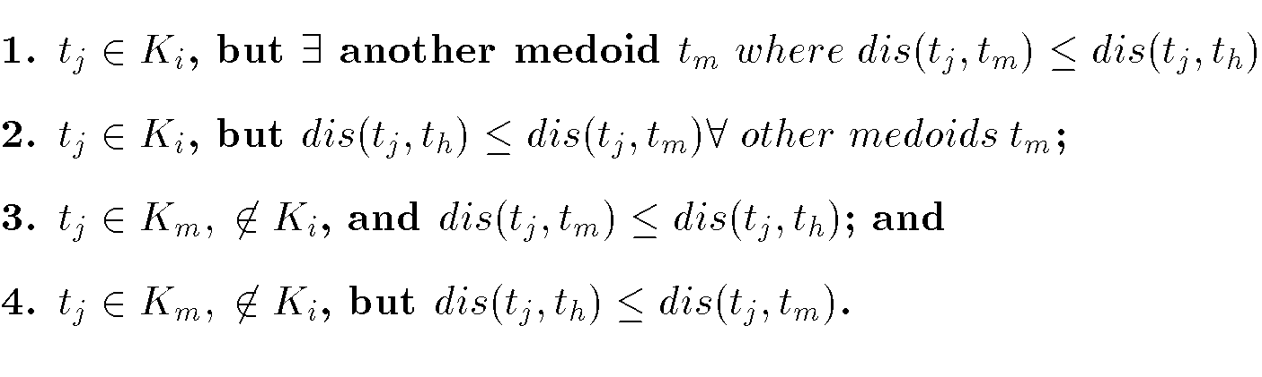
PAM Cost Calculation
At each step in algorithm, medoids are changed if the overall cost is improved.
C_{jih} – cost change for an item t_{j} associated with swapping medoid t_{i} with non-medoid t_{h}.

Slide 45
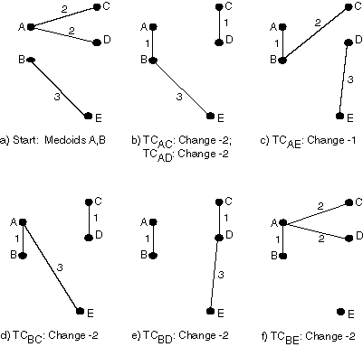
PAM

Slide 46
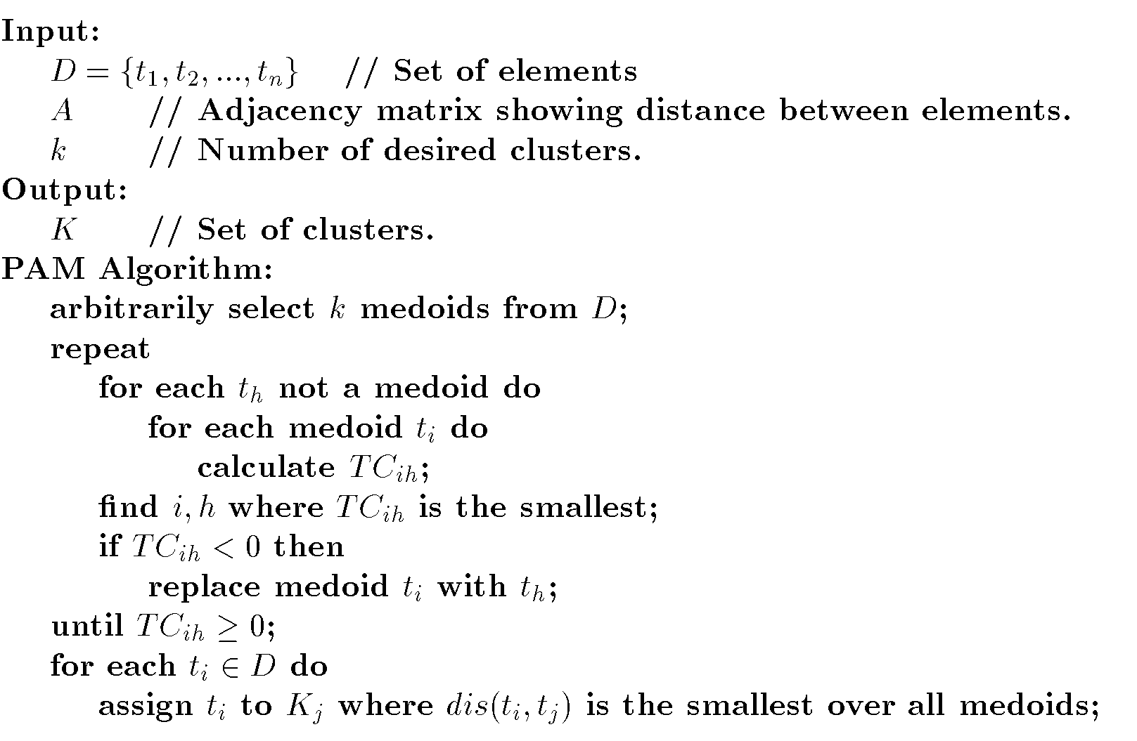
PAM Algorithm

Slide 47
Adv & Disadv. of PAM
PAM is more robust than k-means in the presence of noise and outliers
Medoids are less influenced by outliers
PAM is efficiently for small data sets but does not scale well for large data sets
For each iteration Cost TC_{ih} for k(n-k) pairs is to be determined
Sampling based method: CLARA

Slide 48
Genetic Algorithm Example
{A,B,C,D,E,F,G,H}
Randomly choose initial solution:
{A,C,E} {B,F} {D,G,H} or
10101000, 01000100, 00010011
Suppose crossover at point four and choose 1st and 3rd individuals:
  10100011, 01000100, 00011000
What should termination criteria be?

Slide 49
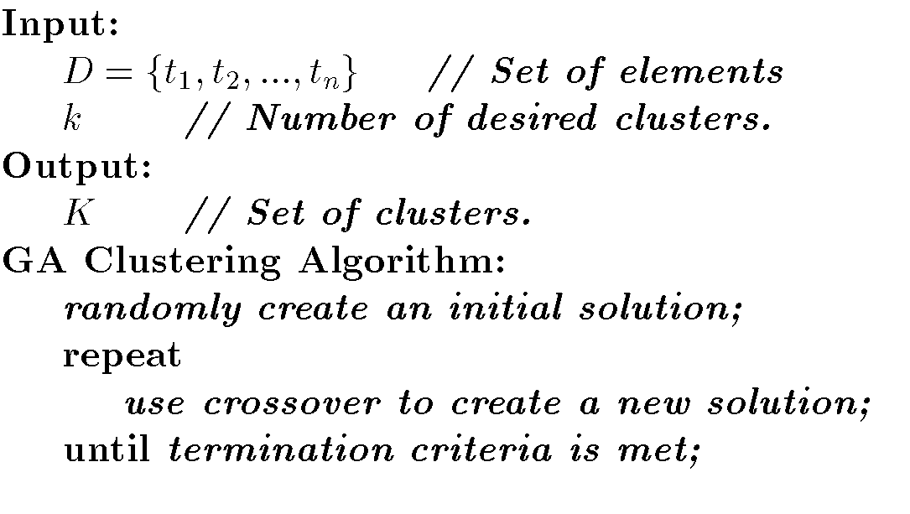
GA Algorithm

Slide 50
CLARA (Clustering Large Applications)
CLARA (Kaufmann and Rousseeuw in 1990)
  Built in statistical analysis packages
It draws multiple samples of the data set, applies PAM on each sample, and gives the best clustering as the output
Strength: deals with larger data sets than PAM
Weakness:
  Efficiency depends on the sample size
  A good clustering based on samples will not necessarily represent a good clustering of the whole data set if the sample is biased

Slide 51
CLARANS (“Randomized” CLARA) (1994)
CLARANS (A Clustering Algorithm based on Randomized Search) (Ng and Han’94)
CLARANS draws sample of neighbors dynamically
The clustering process can be presented as searching a graph where every node is a potential solution, that is, a set of k medoids
If the local optimum is found, CLARANS starts with new randomly selected node in search for a new local optimum
It is more efficient and scalable than both PAM and CLARA

Slide 52
Hierarchical Clustering
Clusters are created in levels actually creating sets of clusters at each level.
Agglomerative Nesting( AGNES)
  Initially each item in its own cluster
  Iteratively clusters are merged together
  Bottom Up
Divisive Analysis(DIANA)
  Initially all items in one cluster
  Large clusters are successively divided
  Top Down

Slide 53
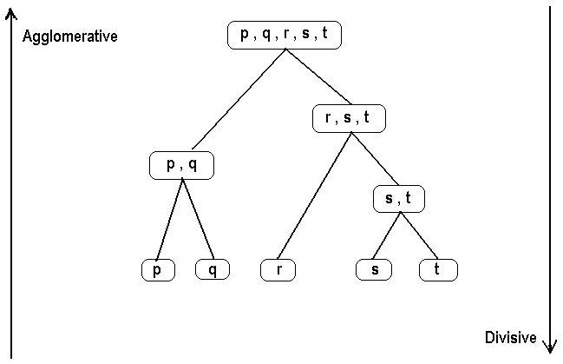
Example

Slide 54
Distance
Distances are normally used to measure the similarity or dissimilarity between two data objects
Properties
  Always positive
  Distance from x to x = zero
  Distance from x to y = Distance from y to x
  Distance from x to y <= distance from x to z + distance from z to y

Slide 55

Distance measures
Euclidian distance
Manhattan distance

Slide 56
Difficulties with Hierarchical Clustering
Can never undo.
No object swapping is allowed
Merge or split decisions ,if not well chosen may lead to poor quality clusters.
do not scale well: time complexity of at least O(n²), where n is the number of total objects.

Slide 57
Hierarchical Algorithms
Single Link
MST Single Link
Complete Link
Average Link

Slide 58
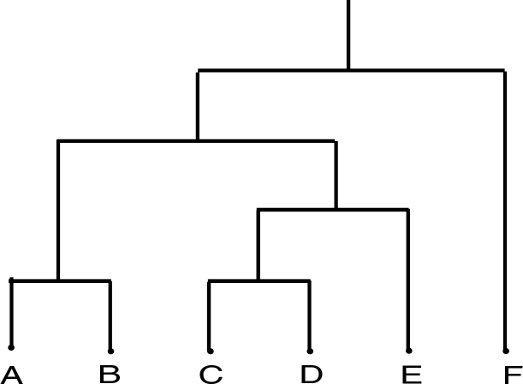
Dendrogram
Dendrogram: a tree data structure which illustrates hierarchical clustering techniques.
Each level shows clusters for that level.
  Leaf – individual clusters
  Root – one cluster
A cluster at level i is the union of its children clusters at level i+1.

Slide 59
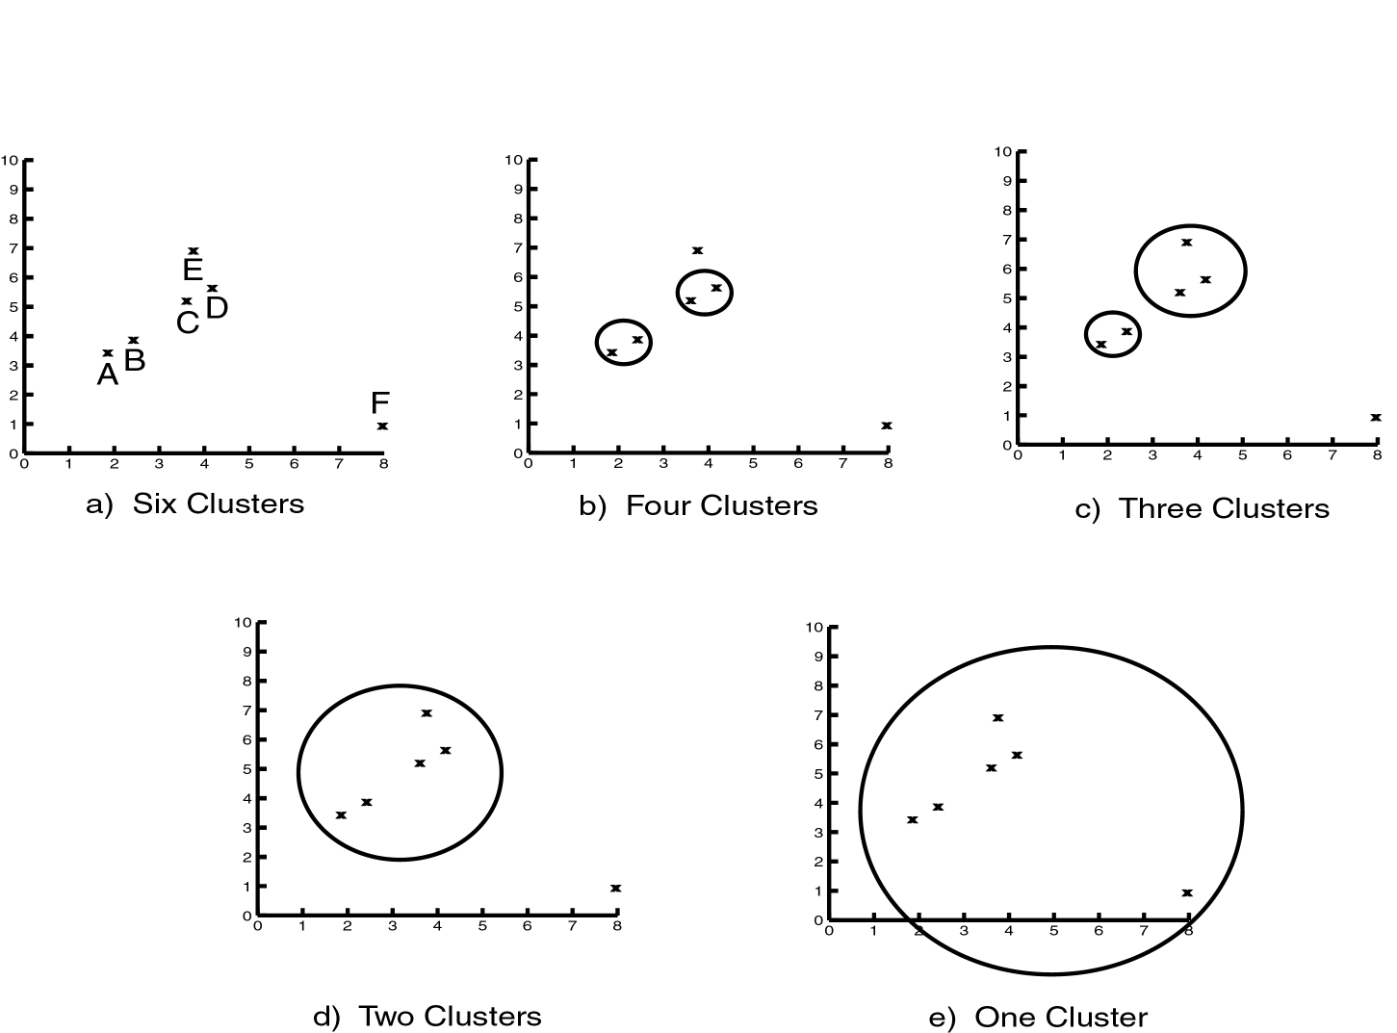
Levels of Clustering

Slide 60
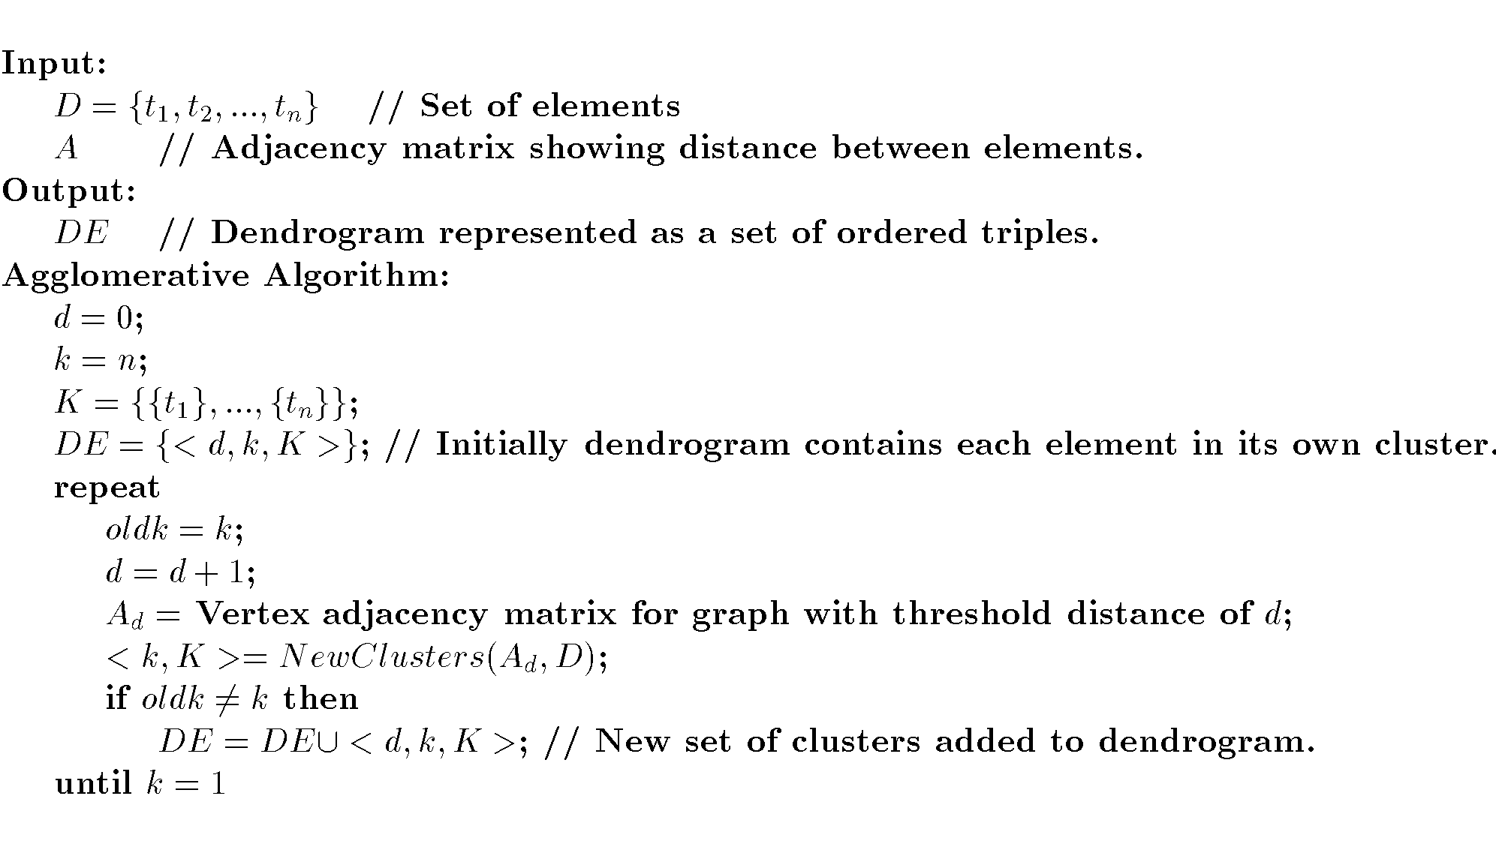
Agglomerative Algorithm

Slide 61
Single Link
View all items with links (distances) between them.
Finds maximal connected components in this graph.
Two clusters are merged if there is at least one edge which connects them.
Uses threshold distances at each level.
Could be agglomerative or divisive.

Slide 62
Single Linkage Clustering
It is an example of agglomerative hierarchical clustering.
We consider the distance between one cluster and another cluster to be equal to the shortest distance from any member of one cluster to any member of the other cluster.

Slide 63
Algorithm
Given a set of N items to be clustered, and an NxN distance (or similarity) matrix, the basic process of single linkage clustering is this:
1.Start by assigning each item to its own cluster, so that if we have N items, we now have N clusters, each containing just one item. Let the distances (similarities) between the clusters equal the distances (similarities) between the items they contain.
2.Find the closest (most similar) pair of clusters and merge them into a single cluster, so that now you have one less cluster.
3.Compute distances (similarities) between the new cluster and each of the old clusters.
4.Repeat steps 2 and 3 until all items are clustered into a single cluster of size N.

Slide 64
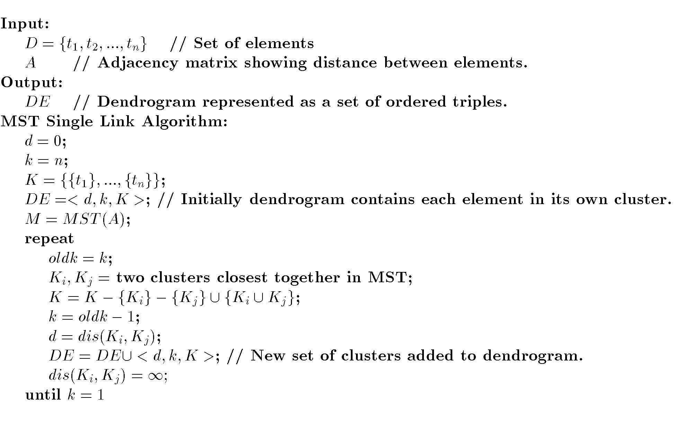
MST Single Link Algorithm

Slide 65
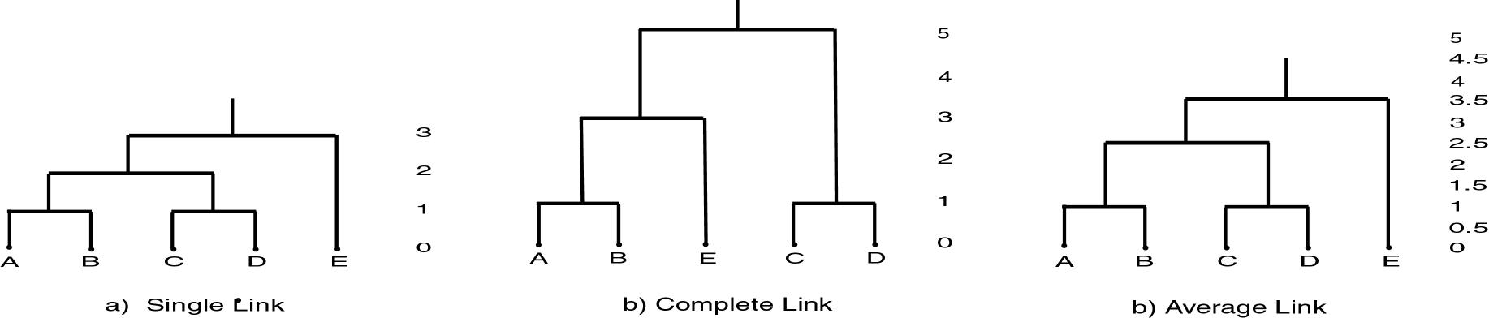
Link Clustering

Slide 66
How to Compute Group Similarity?
Three Popular Methods:
Given two groups g1 and g2,
Single-link algorithm: s(g1,g2)= similarity of the closest pair
Complete-link algorithm: s(g1,g2)= similarity of the farthest pair
Average-link algorithm: s(g1,g2)= average of similarity of all pairs

Slide 67
Three Methods Illustrated
complete-link algorithm
g1
g2
?
……
Single-link algorithm
average-link algorithm

Slide 68
Hierarchical: Single Link
cluster similarity = similarity of two most similar members
- Potentially long and skinny clusters
+ Fast
Notes:
I will start by motivating the work
next describe the Novel algorithm we developed
and then describe the experimental evaluation and present our results

Slide 69
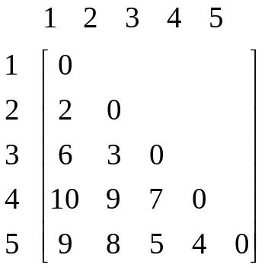
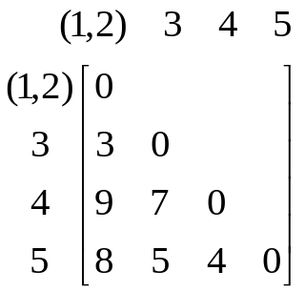
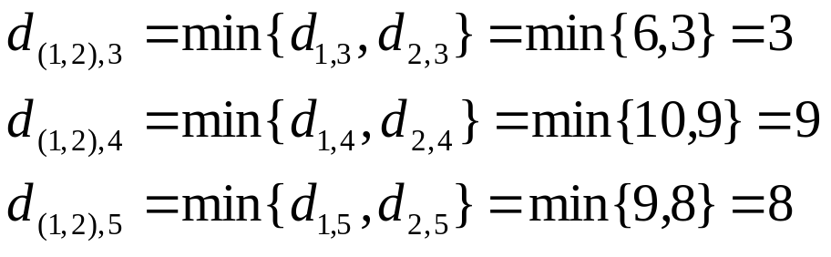
Example: single link
5
4
3
2
1

Slide 70
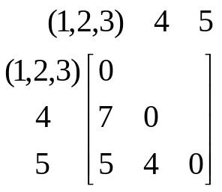
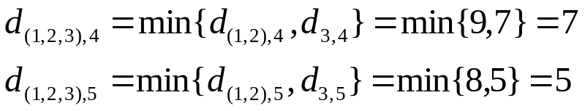
Example: single link
5
4
3
2
1

Slide 71

Example: single link
5
4
3
2
2
1

Slide 72
Hierarchical: Complete Link
cluster similarity = similarity of two least similar members
+ tight clusters
- slow
Notes:
I will start by motivating the work
next describe the Novel algorithm we developed
and then describe the experimental evaluation and present our results

Slide 73
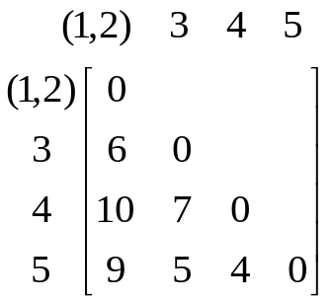
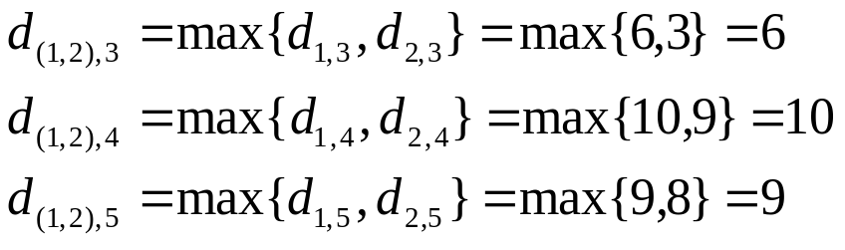
Example: complete link
5
4
3
2
2
1

Slide 74
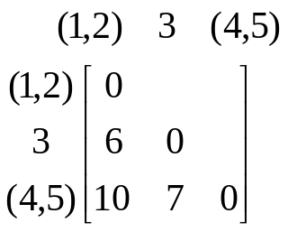
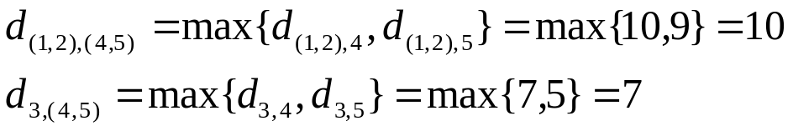
Example: complete link
5
4
3
2
1

Slide 75

Example: complete link
5
4
3
2
1

Slide 76
Hierarchical: Average Link
cluster similarity = average similarity of all pairs
+ tight clusters
- slow
Notes:
I will start by motivating the work
next describe the Novel algorithm we developed
and then describe the experimental evaluation and present our results

Slide 77
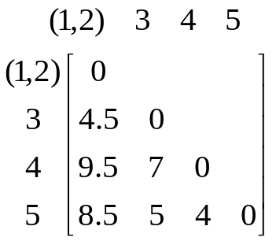
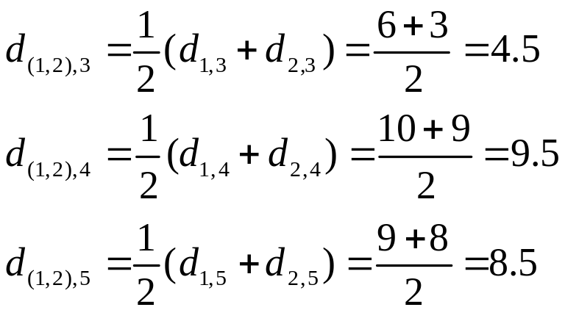
Example: average link
5
4
3
2
1

Slide 78
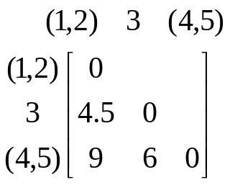
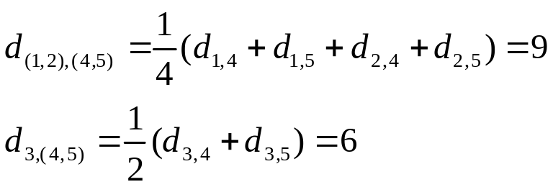
Example: average link
5
4
3
2
1

Slide 79
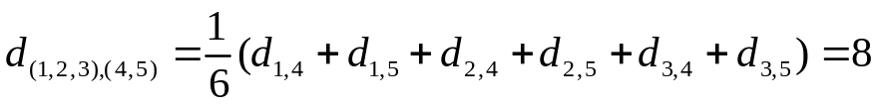
Example: average link
5
4
3
2
1

Slide 80
Comparison of the Three Methods
Single-link
  “Loose” clusters
  Individual decision, sensitive to outliers
Complete-link
  “Tight” clusters
  Individual decision, sensitive to outliers
Average-link
  “In between”
  Group decision, insensitive to outliers
Which one is the best? Depends on what you need!

Slide 81
An Example
Let’s now see a simple example:
a hierarchical clustering of distances in kilometers between some Italian cities. The method used is single-linkage.

Slide 82
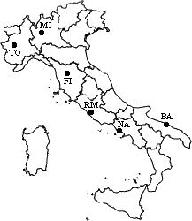
Input distance matrix (L = 0 for all the clusters):
c | BA | FI | MI | NA | RM | TO
BA | 0 | 662 | 877 | 255 | 412 | 996
FI | 662 | 0 | 295 | 468 | 268 | 400
MI | 877 | 295 | 0 | 754 | 564 | 138
NA | 255 | 468 | 754 | 0 | 219 | 869
RM | 412 | 268 | 564 | 219 | 0 | 669
TO | 996 | 400 | 138 | 869 | 669 | 0
The nearest pair of cities is MI and TO, at distance 138. These are merged into a single cluster called "MI/TO". The level of new cluster is L(MI/TO) = 138

Slide 83
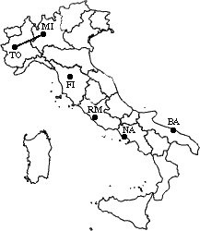
 | BA | FI | MI/TO | NA | RM
BA | 0 | 662 | 877 | 255 | 412
FI | 662 | 0 | 295 | 468 | 268
MI/TO | 877 | 295 | 0 | 754 | 564
NA | 255 | 468 | 754 | 0 | 219
RM | 412 | 268 | 564 | 219 | 0
Now, min d(i,j) = d(NA,RM) = 219 => merge NA and RM into a new cluster called NA/RM L(NA/RM) = 219

Slide 84
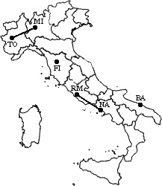
 | BA | FI | MI/TO | NA/RM
BA | 0 | 662 | 877 | 255
FI | 662 | 0 | 295 | 268
MI/TO | 877 | 295 | 0 | 564
NA/RM | 255 | 268 | 564 | 0
min d(i,j) = d(BA,NA/RM) = 255 => merge BA and NA/RM into a new cluster called BA/NA/RM
L(BA/NA/RM) = 474

Slide 85
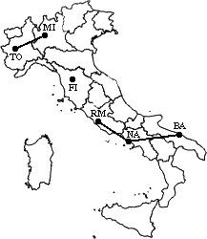
 | BA/NA/RM | FI | MI/TO
BA/NA/RM | 0 | 268 | 564
FI | 268 | 0 | 295
MI/TO | 564 | 295 | 0
min d(i,j) = d(BA/NA/RM,FI) = 268 => merge BA/NA/RM and FI into a new cluster called BA/FI/NA/RM
L(BA/FI/NA/RM) = 742

Slide 86
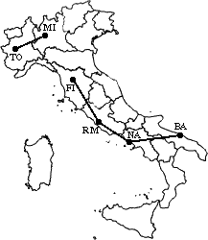
 | BA/FI/NA/RM | MI/TO
BA/FI/NA/RM | 0 | 295
MI/TO | 295 | 0
Finally, we merge the last two clusters at level 1037.
The process is summarized by the following
dendrogram:

Slide 87
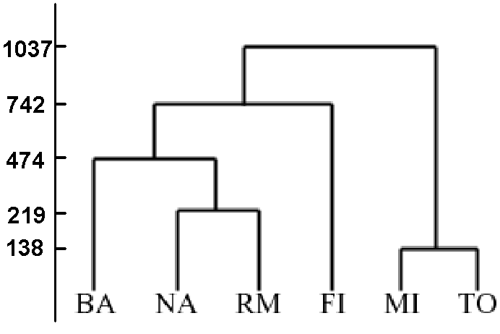
Dendrogram

Slide 88
Dendrogram

Slide 89
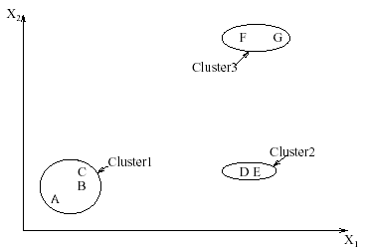
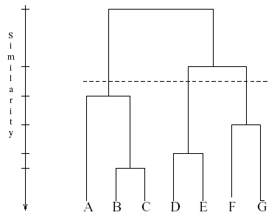
Interpreting Dendrograms
Clusters Dendrogram

Slide 90
Softwares
SPSS
SAS
S Plus

Slide 91
Advantages
Single linkage is best suited to detect lined structure
Invariant against monotonic transformation of the dissimilarities or similarities. For example, the results do not change, if the dissimilarities or similarities are squared, or if we take the log.
Intuitive

Slide 92
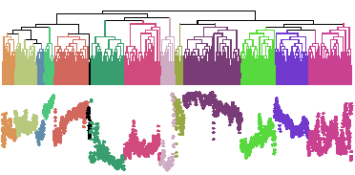
Problems with Dendrogram
Messy to construct if number of points is large.
Number of observations = 6113

Slide 93
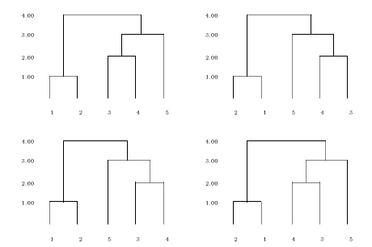

Comparing two Dendrograms is not straightforward
The four dendrograms all represent the same data. They can be obtained from each other by rotating a few branches.
H_{n} denotes the number of simply equivalent dendrograms for n objects.

Slide 94
Clustering Large Databases
Most clustering algorithms assume a large data structure which is memory resident.
Clustering may be performed first on a sample of the database then applied to the entire database.
Algorithms
  BIRCH
  DBSCAN
  CURE

Slide 95
Improvements
Integration of hierarchical method with other clustering methods for multi phase clustering.
BRICH (Balanced Iterative Reducing and Clustering Using Hierarchies)- uses CF-tree and incrementally adjusts the quality of sub-clusters.
CURE (Clustering Using Representatives)-selects well-scattered points from the cluster and then shrinks them towards the center of the cluster by a specified fraction.

Slide 96
BIRCH
Balanced Iterative Reducing and Clustering using Hierarchies
Incremental, hierarchical, one scan
Save clustering information in a tree
Each entry in the tree contains information about one cluster
New nodes inserted in closest entry in tree

Slide 97
Clustering Feature
CF : (N,LS,SS)
  N: Number of points in cluster
  LS: Sum of points in the cluster
  SS: Sum of squares of points in the cluster
CF Tree
  Balanced search tree
  Node has CF triple for each child
  Leaf node represents cluster and has CF value for each subcluster in it.
  Subcluster has maximum diameter

Slide 98
BIRCH
Use CF (Clustering Feature) tree, a hierarchical data structure for multiphase clustering
  Phase 1: scan DB to build an initial in-memory CF tree (a multi-level compression of the data into sub-clusters that tries to preserve the inherent clustering structure of the data)
  Phase 2: use an arbitrary clustering algorithm to cluster the leaf nodes of the CF-tree
Scales linearly: finds a good clustering with a single scan and improves the quality with a few additional scans
Makes full use of available memory to derive finest possible sub-clusters (to ensure accuracy) while minimizing data scans (to ensure efficiency).

Slide 99
CF Tree
B = Max. no. of CF in a non-leaf node
L = Max. no. of CF in a leaf node
Root
CF₁
CF₂
CF₃
CF₆
child₁
child₂
child₃
child₆
Non-leaf node
CF₁
CF₂
CF₃
CF₅
child₁
child₂
child₃
child₅
Leaf node
Leaf node
prev
CF₁
CF₂
CF₆
next
prev
CF₁
CF₂
CF₄
next
T= Max. radius of a sub-cluster

Slide 100
CF Tree
  A non leaf node represents a cluster made up of all sub clusters represented by its entries.
  A leaf node also represents a cluster made up of all sub clusters represented by its entries. The diameter or radius of any entry has to be less than the threshold T.
  The tree size is a function of T. The larger T is the smaller the tree is.
  A CF tree will be built dynamically as new data objects are inserted.
  B and L are determined by page size P.

Slide 101
Insertion into a CF Tree
  Identifying the appropriate leaf:
  Recursively descends the CF tree to find closest child node.
  Modifying the leaf:
  If there is no space on leaf, node splitting is done by choosing the farthest pair of entries as seeds, and redistributing remaining entries.
  Modifying the path to the leaf:
  We must update the CF info for each non leaf entry on the path to leaf.
  A Merging Refinement:
A simple merging step helps to improve problems of splits
caused by page splits.

Slide 102
Phases of BIRCH Algorithm
  Phase 1 is to scan all data and build an initial in memory CF Tree using the given amount of memory and recycling disk space.
  Phase 2 is to condense into desirable range by building a smaller CF tree, for applying global or semi global clustering method.
  Phase 3 apply global or semi global algorithm to cluster all leaf entries.
  Phase 4 is optional and entails additional passes over data to correct inaccuracies and refines the cluster further.

Slide 103
Effectiveness
Scales linearly: finds a good clustering with a single scan and improves the quality with a few additional scans.
One scan process: trees can be rebuild easily.
Complexity= O(n)
Weakness: handles only numeric data, and sensitive to the order of the data record.

Slide 104
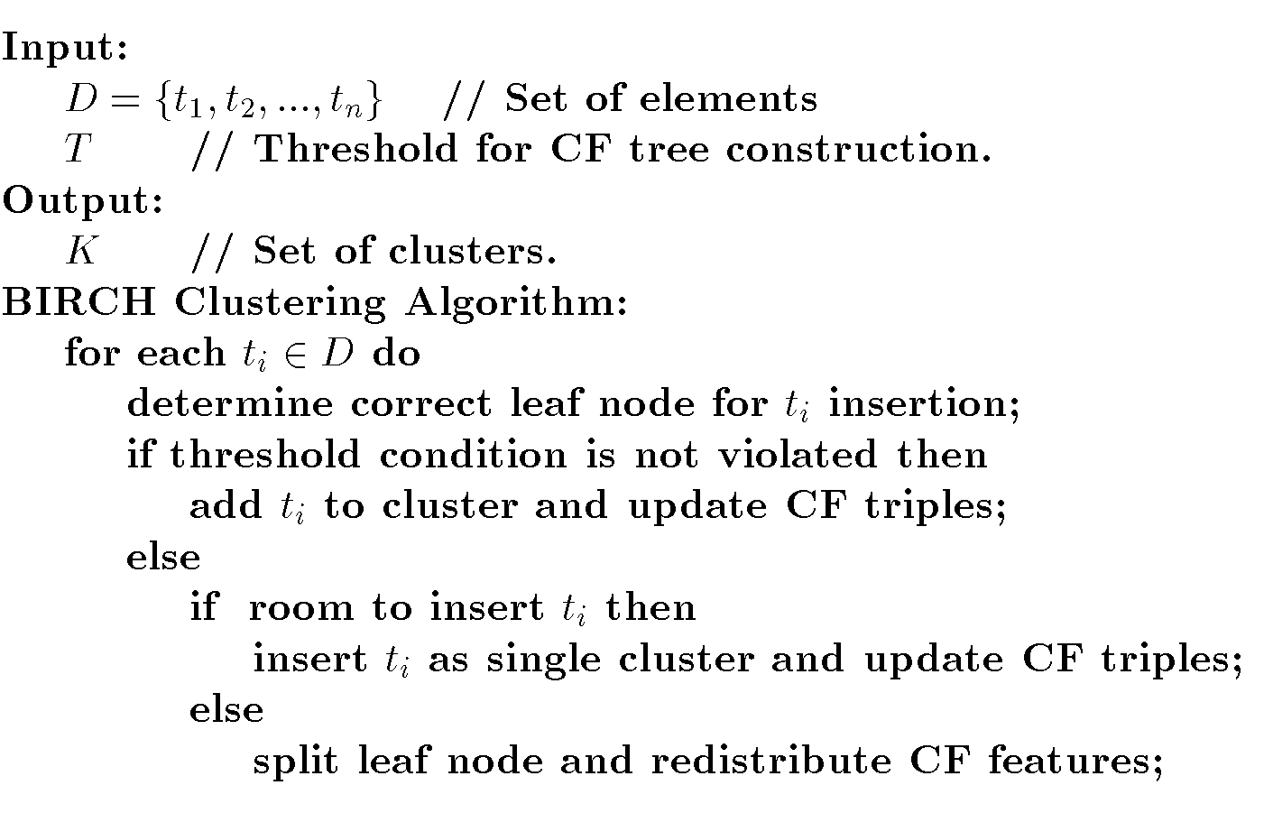
BIRCH Algorithm

Slide 105
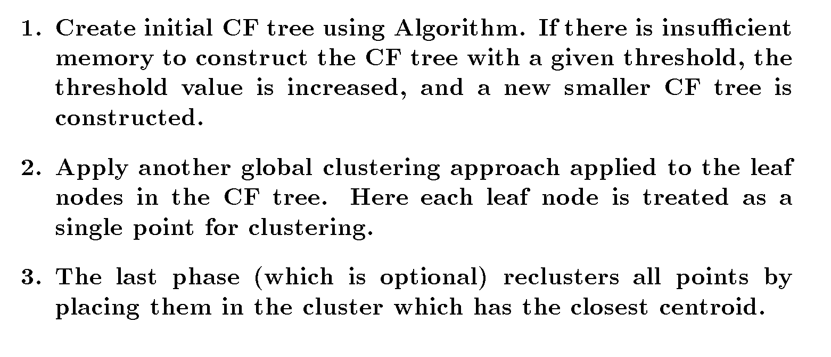
Improve Clusters

Slide 106
CURE
Clustering Using Representatives
Use many points to represent a cluster instead of only one
Points will be well scattered

Slide 107
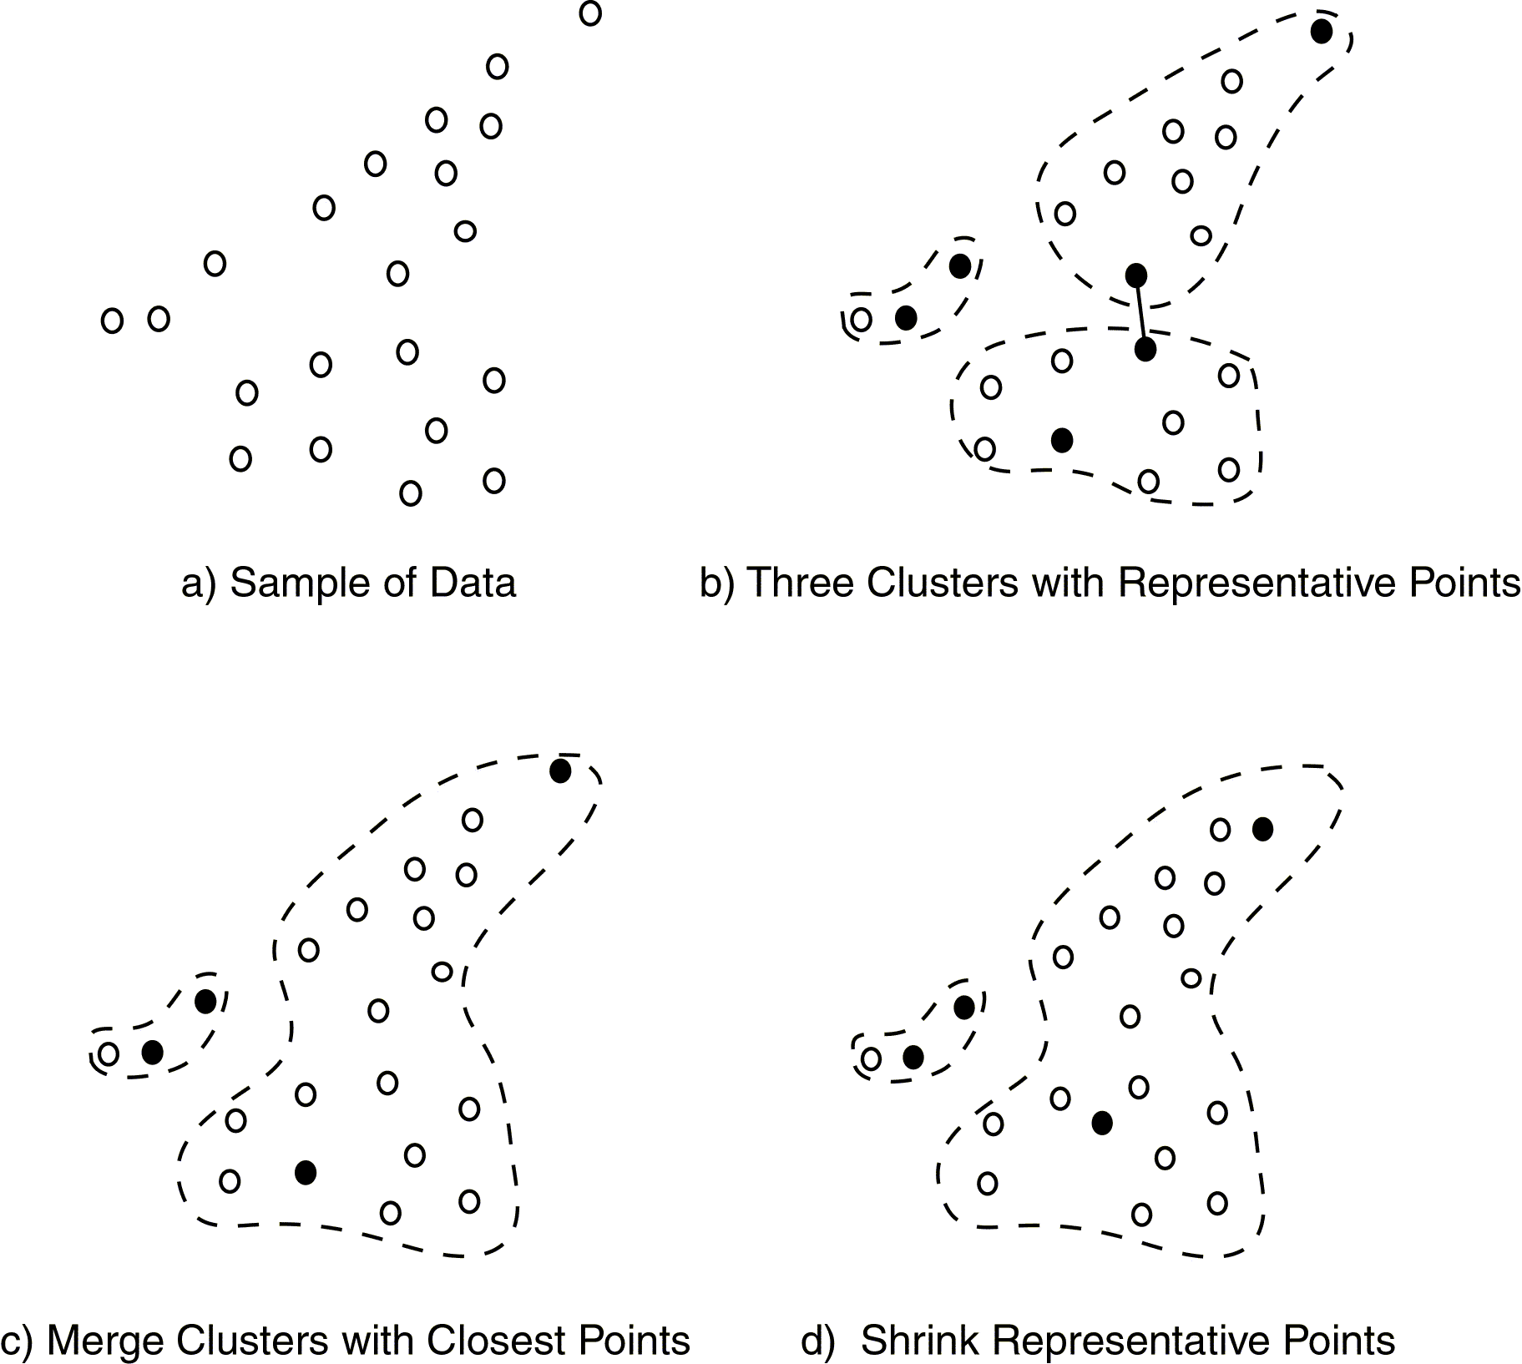
CURE Approach

Slide 108
Cure: Shrinking Representative Points
y
y
x
x
Shrink the multiple representative points towards the gravity center by a fraction of α.
Multiple representatives capture the shape of the cluster

Slide 109
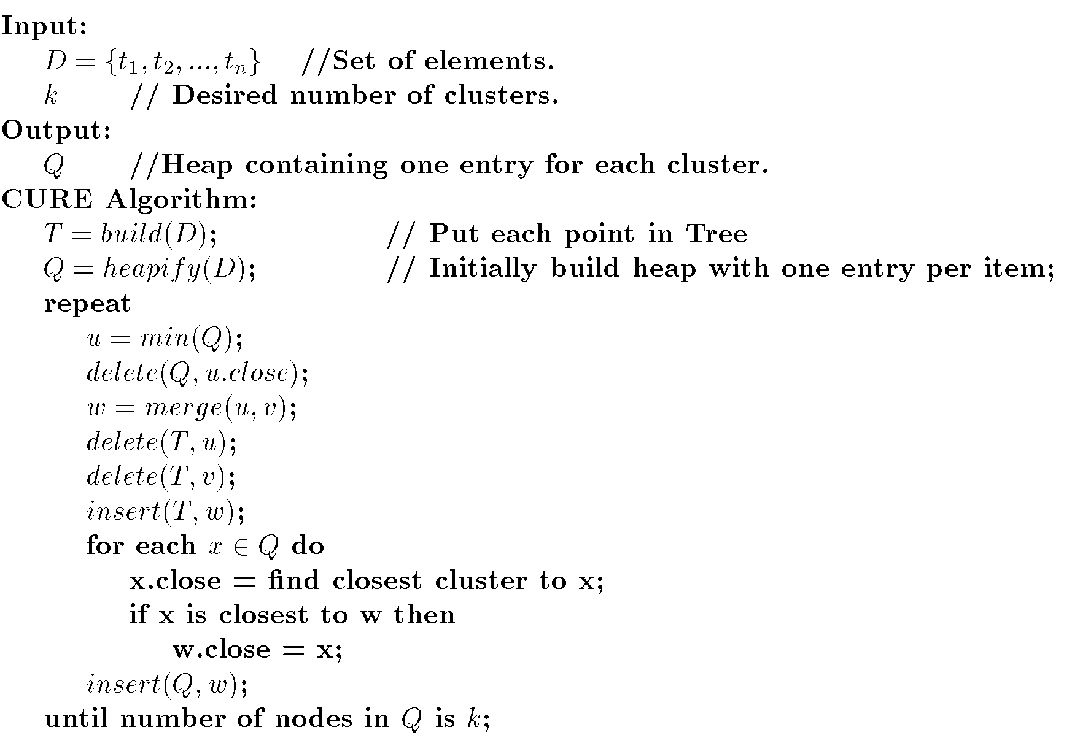
CURE Algorithm

Slide 110
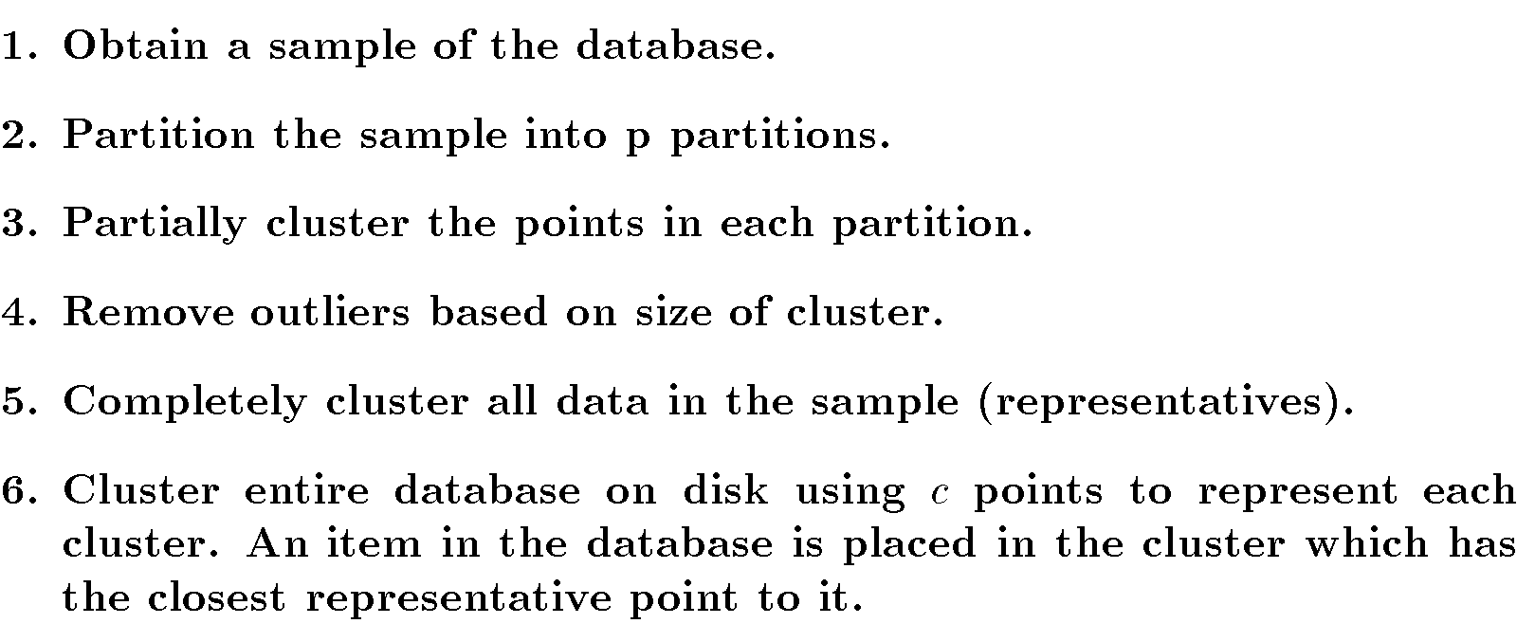
CURE for Large Databases

Slide 111
Effectiveness
Produces high quality clusters in presence of outliers, allowing complex shapes and different sizes.
One scan
Complexity= O(n)
Sensitive to user-specified parameters (sample size, desired clusters, shrinking factor etc)
Does not handle categorical attributes (similarity of two clusters).

Slide 112
Other Approaches to Clustering
Density-based methods
  Based on connectivity and density functions
  Filter out noise, find clusters of arbitrary shape
Grid-based methods
  Quantize the object space into a grid structure
Model-based
  Use a model to find the best fit of data

Slide 113
Density-Based Clustering Methods
Major features:
  Discover clusters of arbitrary shape
  Handle noise
  One scan
  Need density parameters as termination condition
Several interesting studies:
  DBSCAN: Ester, et al. (KDD’96)
  OPTICS: Ankerst, et al (SIGMOD’99).
  DENCLUE: Hinneburg & D. Keim (KDD’98)
  CLIQUE: Agrawal, et al. (SIGMOD’98)

Slide 114
Density-Based Method: DBSCAN
Density-Based Spatial Clustering of Applications with Noise
Clusters are dense regions of objects separated by regions of low density ( noise)
Outliers will not effect creation of cluster
Input
  MinPts – minimum number of points in any cluster
  Є – for each point in cluster there must be another point in it less than this distance away.

Slide 115
Density-Based Method: DBSCAN
Є-neighborhood: Points within Є distance of a point.
N_{Є} (p) :{q belongs to D | dist(p,q) <= Є}
Core point: Є -neighborhood dense enough (MinPts)
Directly density-reachable: A point p is directly density-reachable from a point q if the distance is small (Є ) and q is a core point.
1) p belongs to N_{Є} (q)
  2) core point condition:
  | N_{Є} (q)| >= MinPts
p
MinPts = 5
Eps = 1 cm
q

Slide 116
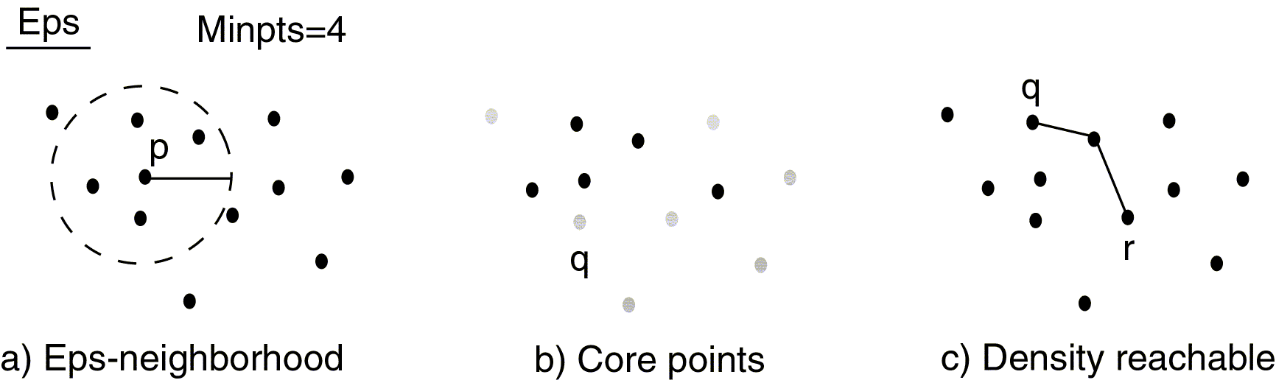
Density Concepts

Slide 117
DBSCAN
Relies on a density-based notion of cluster: A cluster is defined as a maximal set of density-connected points wrt density reachability
Every object not contained in any clusteris considered as noise
Discovers clusters of arbitrary shape in spatial databases with noise
Outlier
Border
Eps = 1cm
MinPts = 5
Core

Slide 118
DBSCAN: The Algorithm
  Arbitrary select a point p
  Retrieve all points density-reachable from p wrt Є and MinPts.
  If p is a core point, a cluster is formed.
  If p is a border point, no points are density-reachable from p and DBSCAN visits the next point of the database.
  Continue the process until all of the points have been processed
  DBSCAN is O(n²) or O(n logn) if spatial index is used.
  Sensitive to user defined parameters.

Slide 119
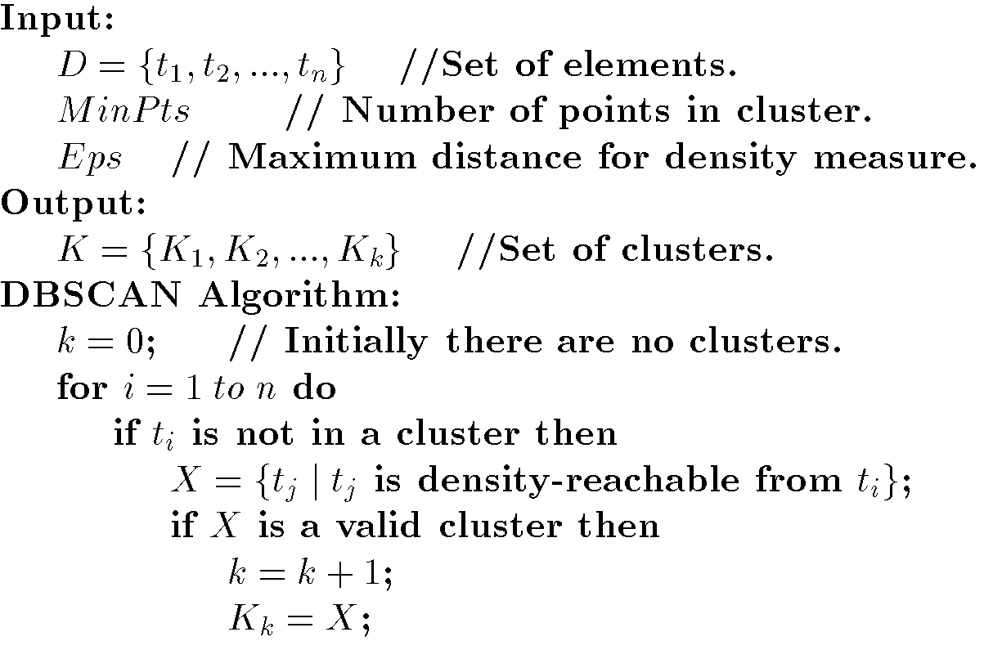
DBSCAN Algorithm

Slide 120
OPTICS: A Cluster-Ordering Method (1999)
Ordering Points To Identify the Clustering Structure
Ankerst, Breunig, Kriegel, and Sander (SIGMOD’99)
Produces a cluster ordering for automatic and interactive cluster analysis wrt density-based clustering structure of the data
This cluster-ordering contains info equiv to the density-based clusterings corresponding to a broad range of parameter settings
Good for both automatic and interactive cluster analysis, including finding intrinsic clustering structure
Can be represented graphically or using visualization techniques

Slide 121
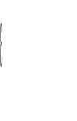

Reachability-distance
undefined
‘
Cluster-order
of the objects

Slide 122
Grid-Based Clustering Method
Uses multi-resolution grid data structure
Quantizes the space into a finite number of cells
Independent of number of data objects
Fast processing time
Several interesting methods
  STING (a STatistical INformation Grid approach) by Wang, Yang and Muntz (VLDB’97)
  WaveCluster by Sheikholeslami, Chatterjee, and Zhang (VLDB’98)
    A multi-resolution clustering approach using wavelet method
  CLIQUE: Agrawal, et al. (SIGMOD’98)

Slide 123
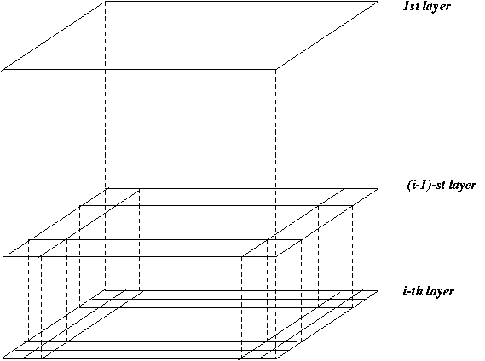
STING: A Statistical Information Grid Approach
Wang, Yang and Muntz (VLDB’97)
The spatial area is divided into rectangular cells
There are several levels of cells corresponding to different levels of resolution

Slide 124
STING: A Statistical Information Grid Approach
Each cell at a high level is partitioned into a number of smaller cells in the next lower level
Statistical info of each cell is calculated and stored beforehand and is used to answer queries
Parameters of higher level cells can be easily calculated from parameters of lower level cell
  count, mean, standard deviation, min, max
  type of distribution—normal, uniform, exponential or none.
  Use a top-down approach to answer spatial data queries
  Start from a pre-selected layer—typically with a small number of cells
  For each cell in the current level compute the confidence interval

Slide 125
STING: A Statistical Information Grid Approach
Remove the irrelevant cells from further consideration
When finish examining the current layer, proceed to the next lower level
Repeat this process until the bottom layer is reached
Advantages:
  Query-independent, easy to parallelize, incremental update
  O(K), where K is the number of grid cells at the lowest level
Disadvantages:
  All the cluster boundaries are either horizontal or vertical, and no diagonal boundary is detected

Slide 126
Model-Based Clustering Methods
Attempt to optimize the fit between the data and some mathematical model
Statistical and AI approach
  Conceptual clustering
    A form of clustering in machine learning
    Produces a classification scheme for a set of unlabeled objects
    Finds characteristic description for each concept (class)
  COBWEB (Fisher’87)
    A popular a simple method of incremental conceptual learning
    Creates a hierarchical clustering in the form of a classification tree
    Each node refers to a concept and contains a probabilistic description of that concept

Slide 127
COBWEB (cont.)
The COBWEB algorithm constructs a classification tree incrementally by inserting the objects into the classification tree one by one.
When inserting an object into the classification tree, the COBWEB algorithm traverses the tree top-down starting from the root node.

Slide 128

COBWEB Clustering Method
A classification tree

Slide 129
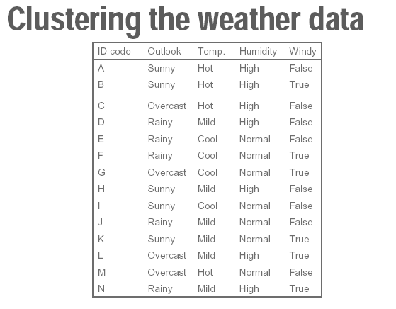
Input: A set of data like before
Can automatically guess the class attribute
  That is, after clustering, each cluster more or less corresponds to one of Play=Yes/No category
  Example: applied to vote data set, can guess correctly the party of a senator based on the past 14 votes!

Slide 130
Clustering: COBWEB
In the beginning tree consists of empty node
Instances are added one by one, and the tree is updated appropriately at each stage
Updating involves finding the right leaf an instance (possibly restructuring the tree)
Updating decisions are based on partition utility and category utility measures

Slide 131


Clustering: COBWEB
The larger this probability, the greater the proportion of class members sharing the value (Vij) and the more predictable the value is of class members.

Slide 132

Clustering: COBWEB
The larger this probability, the fewer the objects that share this value (Vij) and the more predictive the value is of class Ck.

Slide 133

Clustering: COBWEB
The formula is a trade-off between intra-class similarity and inter-class dissimilarity, summed across all classes (k), attributes (i), and values (j).

Slide 134

Clustering: COBWEB

Slide 135

Clustering: COBWEB
Increase in the expected number of attribute values that can be correctly guessed (Posterior Probability)
The expected number of correct guesses give no such knowledge (Prior Probability)

Slide 136

The Category Utility Function
The COBWEB algorithm operates based on the so-called category utility function (CU) that measures clustering quality.
If we partition a set of objects into m clusters, then the CU of this particular partition is
Question: Why divide by
m?
- hint: if m=#objects, CU is max!

Slide 137
COBWEB : Four basic functions
At each node, the COBWEB algorithm considers 4 possible operations and select the one that yields the highest CU function value:
        Insert
        Create
        Merge
        Split

Slide 138
COBWEB : Functions (cont.)
Insertion means that the new object is inserted into one of the existing child nodes. The COBWEB algorithm evaluates the respective CU function value of inserting the new object into each of the existing child nodes and selects the one with the highest score.
The COBWEB algorithm also considers creating a new child node specifically for the new object.

Slide 139
COBWEB : Functions (cont.)
The COBWEB algorithm considers merging the two existing child nodes with the highest and second highest scores.
P
P
Merge
…
…
…
…
…
A
B
N
…
A
B

Slide 140
COBWEB : Functions (cont.)
The COBWEB algorithm considers splitting the existing child node with the highest score.
P
P
Split
…
…
…
…
…
A
B
N
…
A
B

Slide 141
More on Statistical-Based Clustering
Limitations of COBWEB
  The assumption that the attributes are independent of each other is often too strong because correlation may exist
  Not suitable for clustering large database data – skewed tree and expensive probability distributions
CLASSIT
  an extension of COBWEB for incremental clustering of continuous data
  suffers similar problems as COBWEB
AutoClass (Cheeseman and Stutz, 1996)
  Uses Bayesian statistical analysis to estimate the number of clusters
  Popular in industry

Slide 142
Other Model-Based Clustering Methods
Neural network approaches
  Represent each cluster as an exemplar, acting as a “prototype” of the cluster
  New objects are distributed to the cluster whose exemplar is the most similar according to some distance measure
Competitive learning
  Involves a hierarchical architecture of several units (neurons)
  Neurons compete in a “winner-takes-all” fashion for the object currently being presented

Slide 143

Model-Based Clustering Methods

Slide 144
Self-organizing feature maps (SOMs)
Clustering is also performed by having several units competing for the current object
The unit whose weight vector is closest to the current object wins
The winner and its neighbors learn by having their weights adjusted
SOMs are believed to resemble processing that can occur in the brain
Useful for visualizing high-dimensional data in 2- or 3-D space

Slide 145

Comparison of Clustering Techniques

